Slide 1
INTELLIGENT TRAFFIC CONTROL

Slide 2
INTRODUCTION:
Now-a-days the traffic in many cities is worst. Many of us got experienced it.
Our valuable time gets wasted at traffic.
To avoid these problems we proposed a system for controlling the traffic light using image processing.
This is a web application which shows the image instances of vehicles at traffic signal are given to the system.
Then it computes the number of vehicles at each side and shows the signal accordingly.

Slide 3
Motivation and problem statement
As the problem of urban traffic congestion spreads, there is a pressing need for introduction of advanced technology to improve the state of art of traffic control.
In current situation, the signal remain green even if the vehicles have passed.
To avoid these problems we proposed a system for controlling the traffic light using image processing.

Slide 4
Existing Systems
Various existing systems for traffic control are:
Manual Controlling requires extra man power. Moreover, only skilled operators can make judgements, hence, there is very high work load on skilled operators.
Automatic Traffic Light performs its functioning through sensors and timers. Depending on timer values, lights are automatically getting ON and OFF.
Microcontroller that controls the traffic lights at the zebra crossing or we can say traffic junction, which is not a flexible method, rather, there is fixed on and off timings for yellow, green and red lights.

Slide 5
Proposed system
The image instances of vehicles at traffic signal are given to the system
Then it computes the number of vehicles at each side and shows the signal accordingly using image processing.

Slide 6
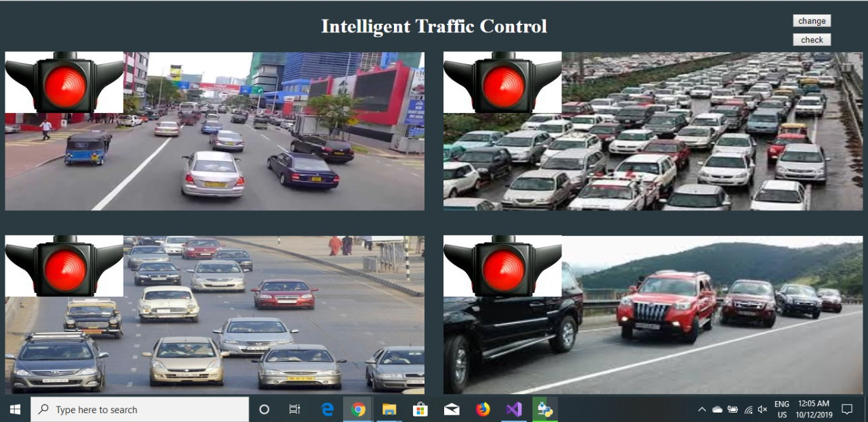
Result

Slide 7
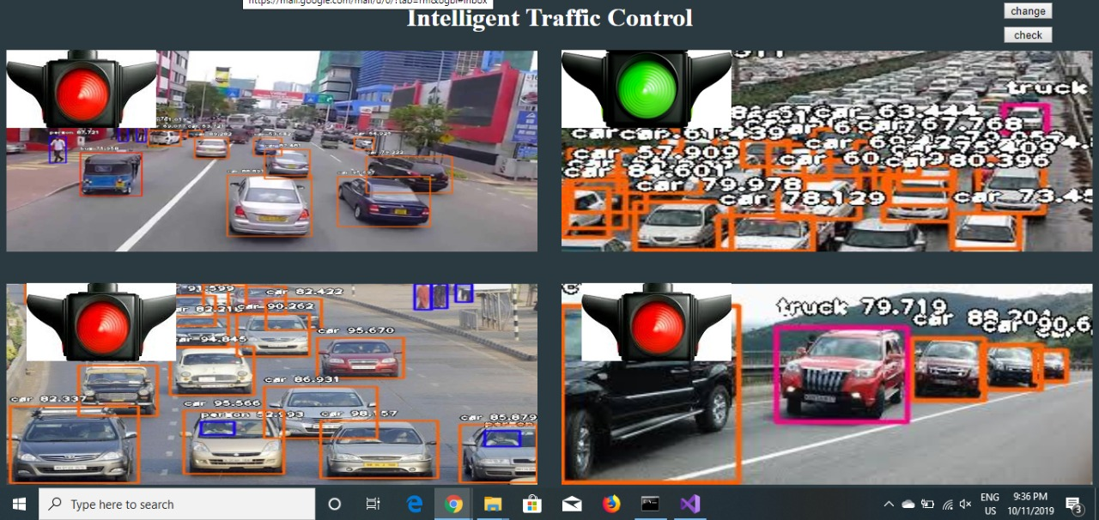
Result

Slide 8
Future Scope
Instead of images we can give directly video through cameas at traffic signal and compute the number of vehicles and show the signal accordingly.

Slide 9
References
https://www.google.co.in
http://flask.palletsprojects.com/en/1.1.x/
https://imageai.readthedocs.io/en/latest/

Slide 10
THE END

